Slide 1
Schlieren Optical Visualization
Victor Padilla
Dr. Alex Craig, Dr. Lutz Taubert, John Flood
4/13/2019

Slide 2
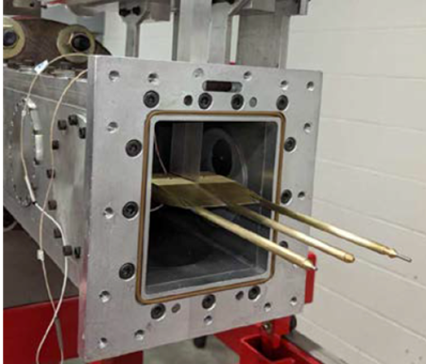
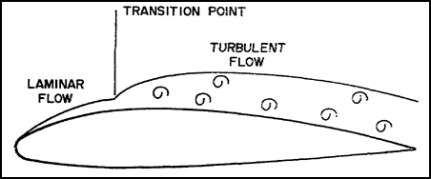
University of Arizona BLST
Boundary-Layer Stability and Transition Laboratory
Research concerning laminar-turbulent transition in fluid flow
Mach 4 Ludwieg Tube Wind Tunnel
100 ms run time
Quiet flow below 14.5 psi
Pressure Transducers
Automated
Mach 5 Ludwieg Tube
100 ms run time
Quiet flow below 200 psi
Pressure Transducers

Slide 3
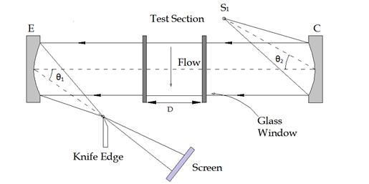
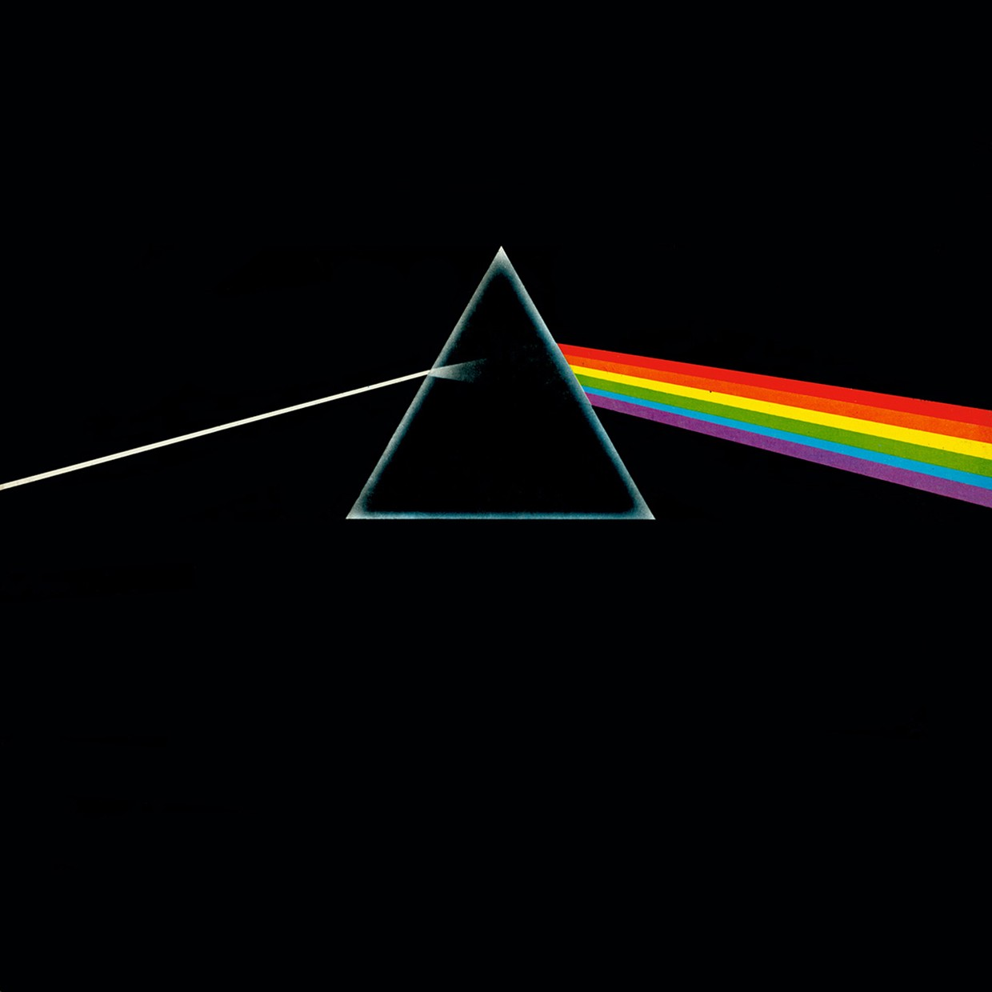
What is Schlieren?
Visual Method of observing density changes in fluids using optics
Conventional Setup
Camera
Monochromatic Point Source for Light
Less scattering/blurriness/diffraction
Resolves possible aberration issue
Lens/Mirrors
Focusing/Filtering
Knife Edge
Controls light intensity
Increases contrast
Blocks certain optical paths of light
Density changes are the driving aspect of projections
Density changes of fluids change light intensity

Slide 4
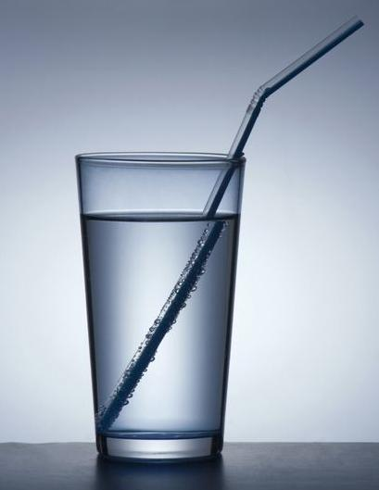
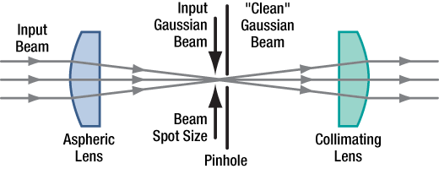

How Schlieren Works
Refractive Index changes
$n=\frac{c}{v}=\frac{Speed of Light in Vacuum}{Speed of Light in Medium }$
Refractive index dependent on fluid/medium density
Velocity of light waves change
Spatial Filtering
Knife Edge
Lens
Mirrors

Slide 5
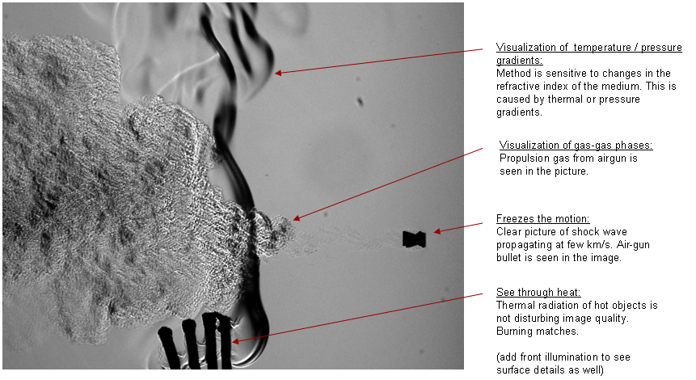
Why Is It Important?
Detection and Visualization
Empirical visual evidence
Shows changes in Temperature, Pressure, and Density
Image Processing
Image processing generates quantifiable results

Slide 6
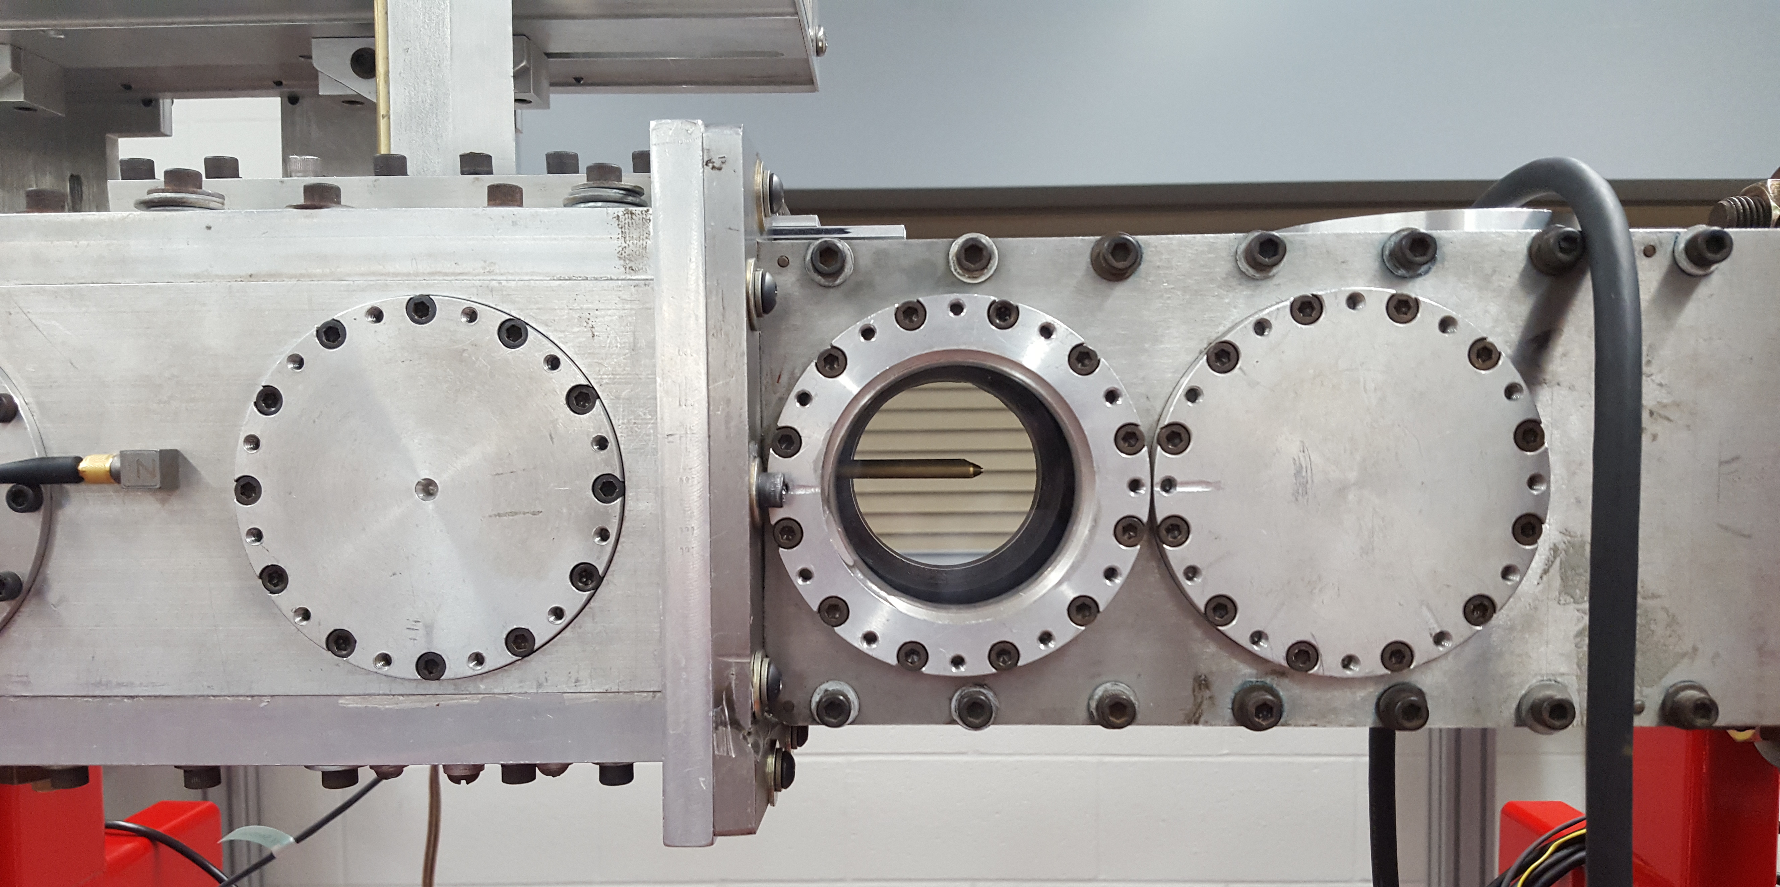
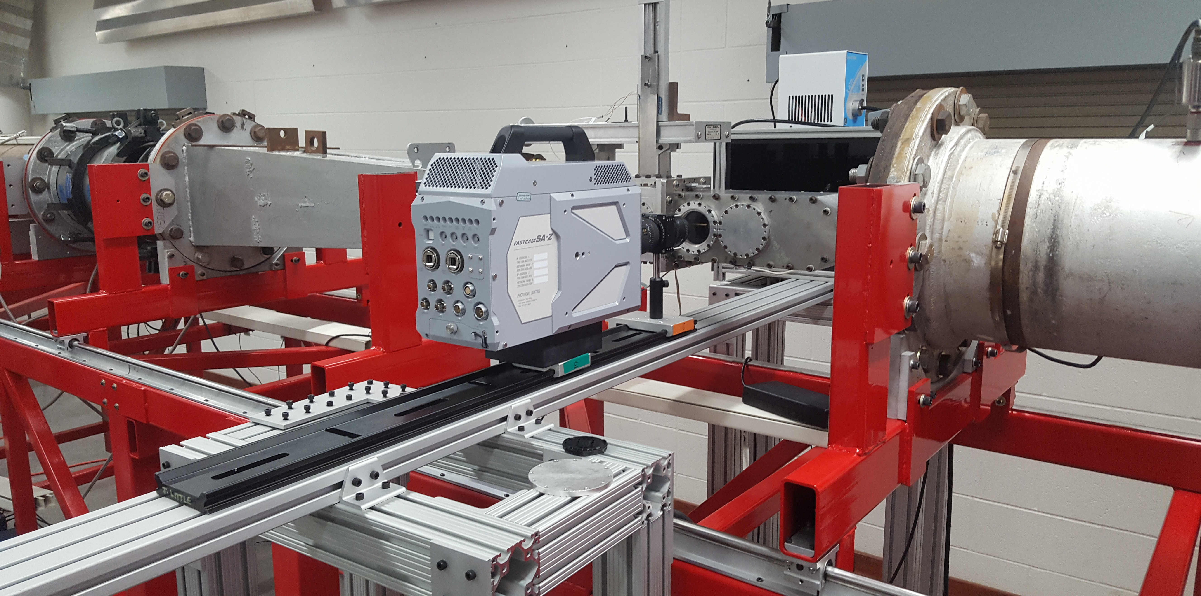
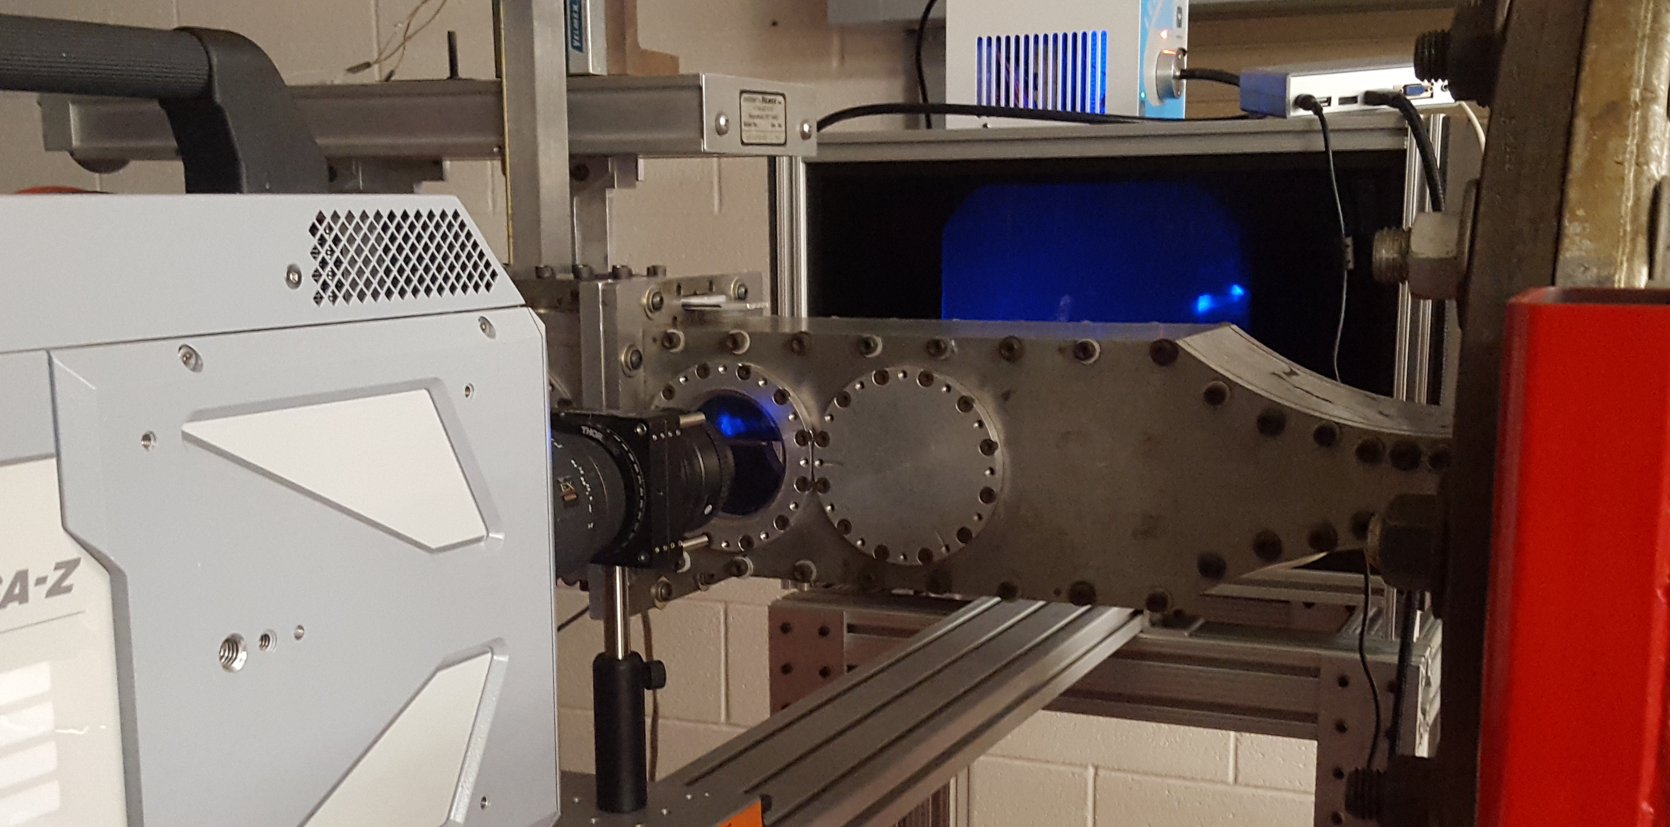
Focusing Schlieren
Checkered Grid Display
Grid lines are opaque and transparent
Act as knife edge
Monochromatic Broad Light Source
Shines behind grid toward camera
Focusing
Camera focuses on light from grid
Grid focusing absolves initial unwanted refractive indices

Slide 7
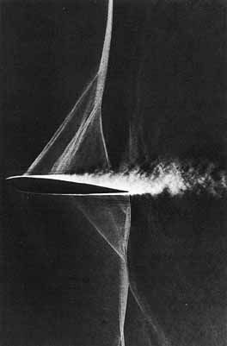
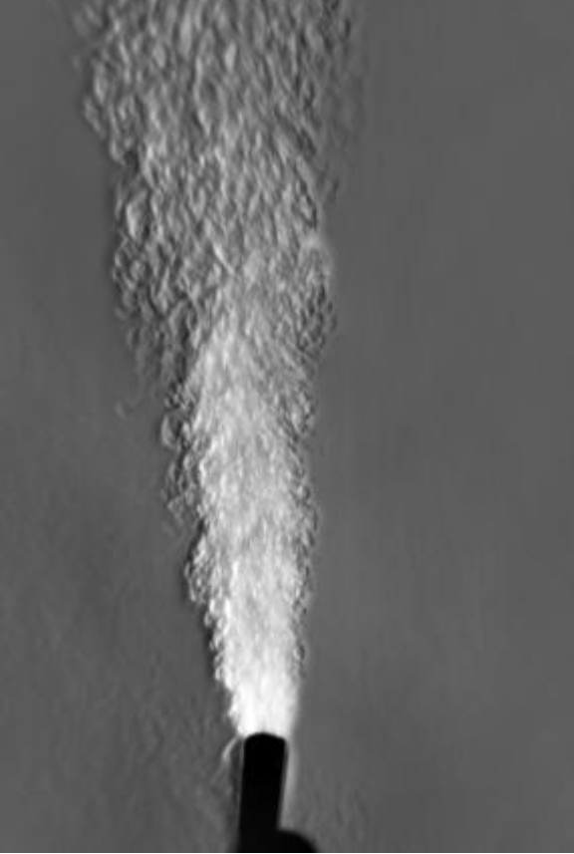
Schlieren Image Examples

Slide 8



Summary
Schlieren Imaging
Method to view density changes in a fluid
Density Changes
Temperature and Pressure changes/effects
Refractive Indices
Different light wave velocities in separate mediums

